Slide 1
Genomic surveillance elucidates Ebola virus origin and transmission during the 2014 outbreak
Molecular Epidemiology Case Study 4
MOLECULAR EPIDEMIOLOGY TRAINING SERIES
OCTOBER 30, 2026

Slide 2
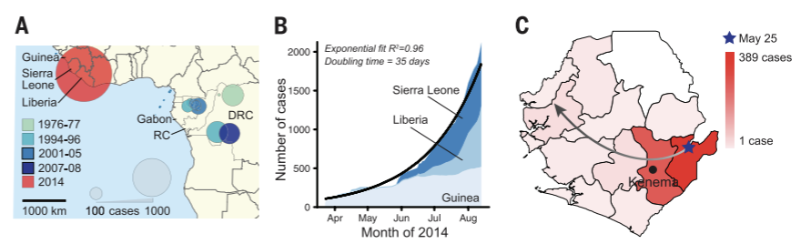
Background & context of the outbreak
78%
34.8 Days
Average case fatality rate
Epidemic doubling time
Outbreak Emergence: Initiated Feb 2014 in Guinea; spread to Liberia, Sierra Leone, and Nigeria.
Sierra Leone Entry: First case confirmed May 25, 2014, linked to a traditional healer's burial.
Key Question: Determine if expansion stemmed from animal reservoir spillovers or sustained human transmission.

Slide 3
Methodology
STEP 1
Patient Cohort
STEP 2
Library Prep
STEP 3
High-Depth Sequencing
STEP 4
Phylodynamics
Collected 99 EBOV genomes from 78 confirmed EVD patients at Kenema Hospital.
Evaluated 4 prep methods; Nextera + Illumina gave highest coverage stability.
Reconstructed BEAST molecular clocks and mapped iSNVs (>0.5% frequency) including 20 genomes from earlier outbreaks.
Achieved >2000x median depth covering >99.9% of viral coding regions.

Slide 4
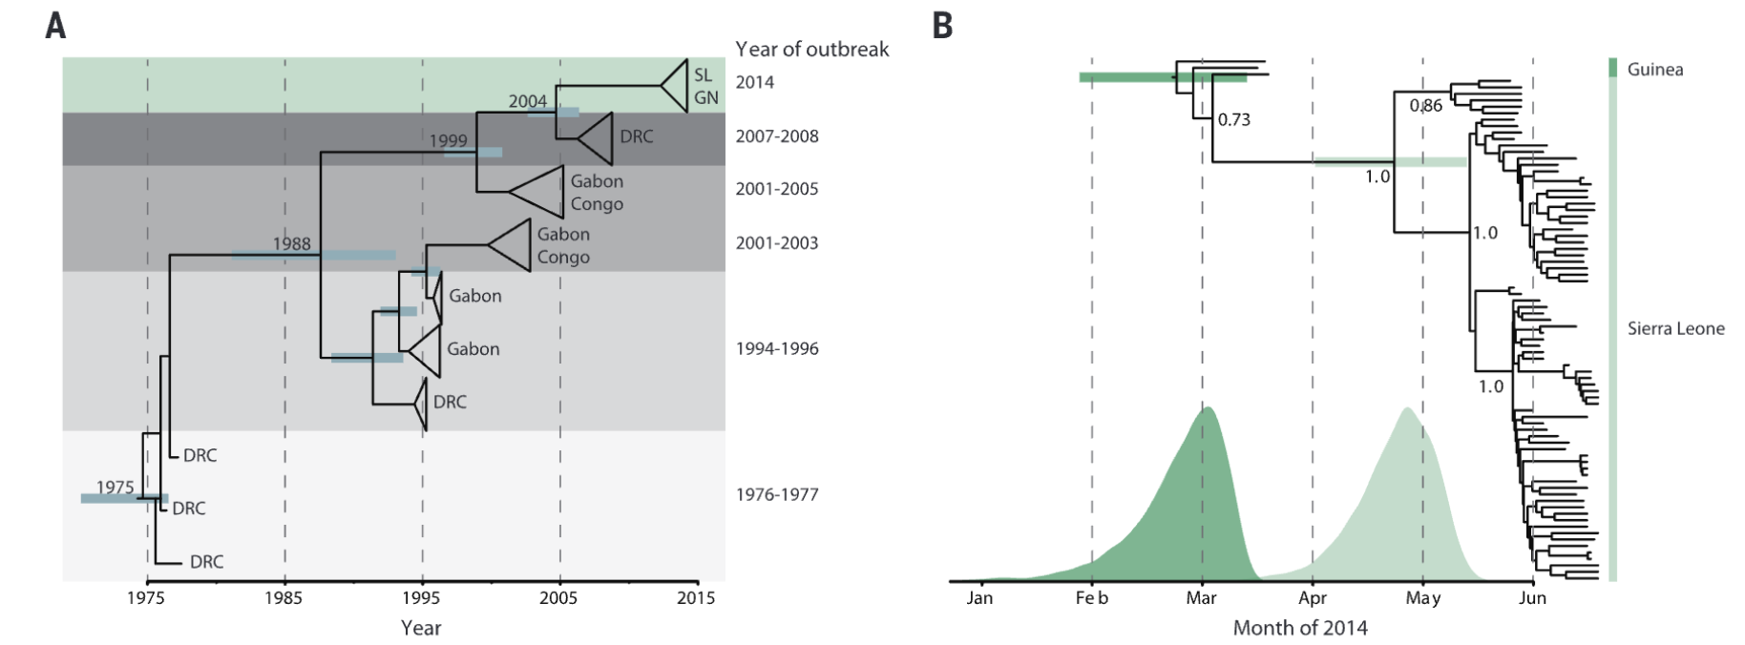
Virus likely spread from Central Africa over last decade
Phylogenetic comparison to earlier outbreaks suggests that the 2014 West African outbreak likely spread from central Africa within the past decade.
Genetic similarity across the sequenced 2014 samples suggests a single transmission event into Central Africa, followed by sustained human-to-human transmission.
Sierra Leone outbreak likely stemmed from introduction of two genetically distinct viruses from Guinea.

Slide 5
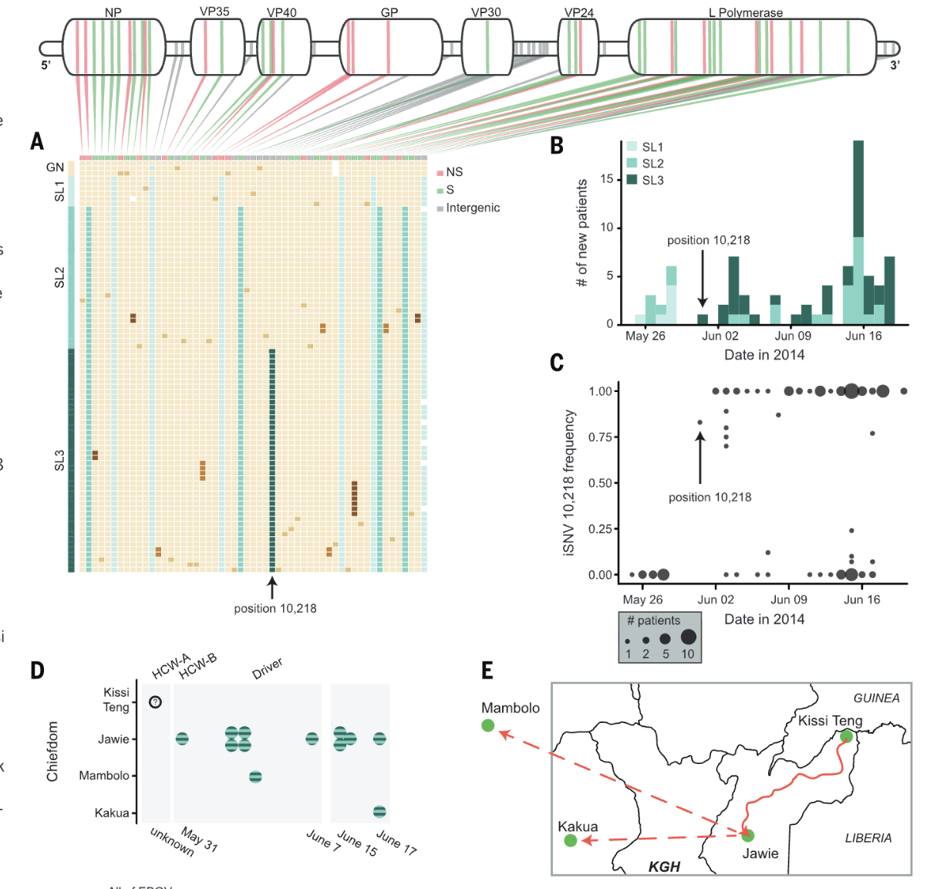
Viral dynamics of central Africa outbreak
Authors use mutations, temporal, and geographic data to gain insights about transmission and epidemiology of central Africa outbreak.

Slide 6
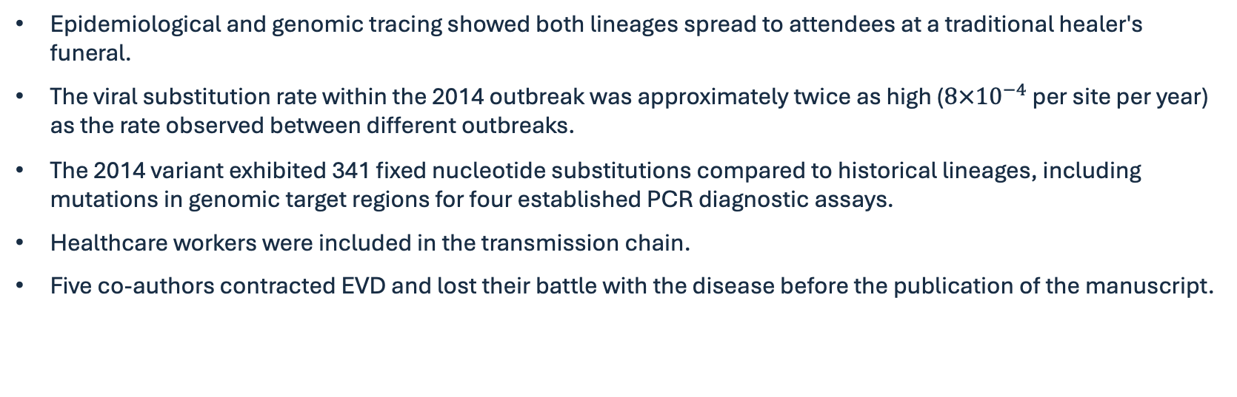
Other findings
Epidemiological and genomic tracing showed both lineages spread to attendees at a traditional healer's funeral.
The viral substitution rate within the 2014 outbreak was approximately twice as high ($8×{10}^{−4}$ per site per year) as the rate observed between different outbreaks.
The 2014 variant exhibited 341 fixed nucleotide substitutions compared to historical lineages, including mutations in genomic target regions for four established PCR diagnostic assays.
Healthcare workers were included in the transmission chain.
Five co-authors contracted EVD and lost their battle with the disease before the publication of the manuscript.

